Slide 1
MLA LINC CURRICULUM FRAMEWORK Literacy to CLB 4
Objectives:
To create consistency in planning and assessment across the LINC program
To reduce the amount of teacher time spent on creating semester course plans
To give teachers more time to focus on day-to-day lesson plan development and delivery
To foster creativity and autonomy within the parameters of a common framework

Slide 2
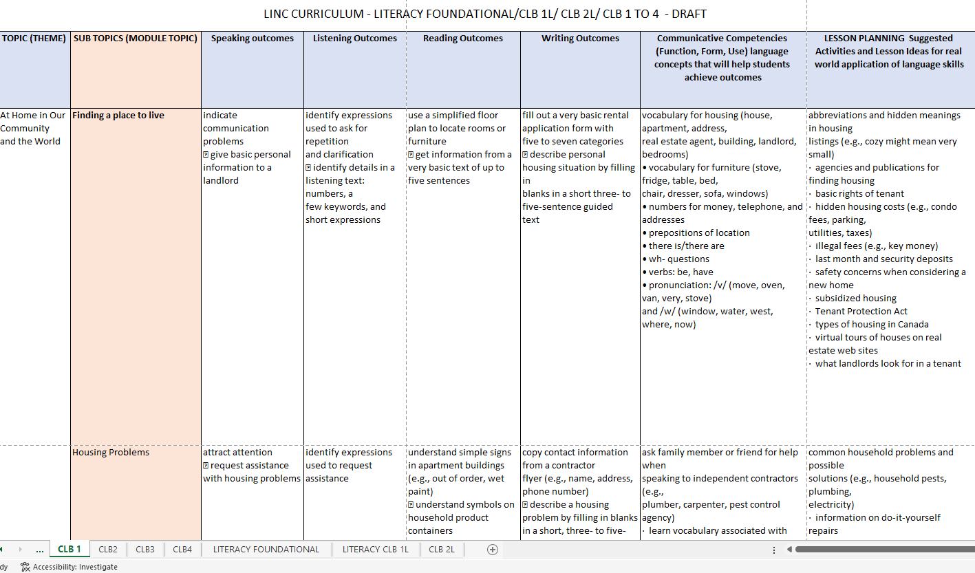
EXCEL File Document Version
(Link to document on Teams)
Each level is divided by themes, topics , language strand outcomes, language concepts, lesson plan ideas. There are a total of 11 themes and 33 modules for CLB 1 to 4 and 8 themes and 24 modules for Literacy. Choose from these to help you plan your semester course.

Slide 3
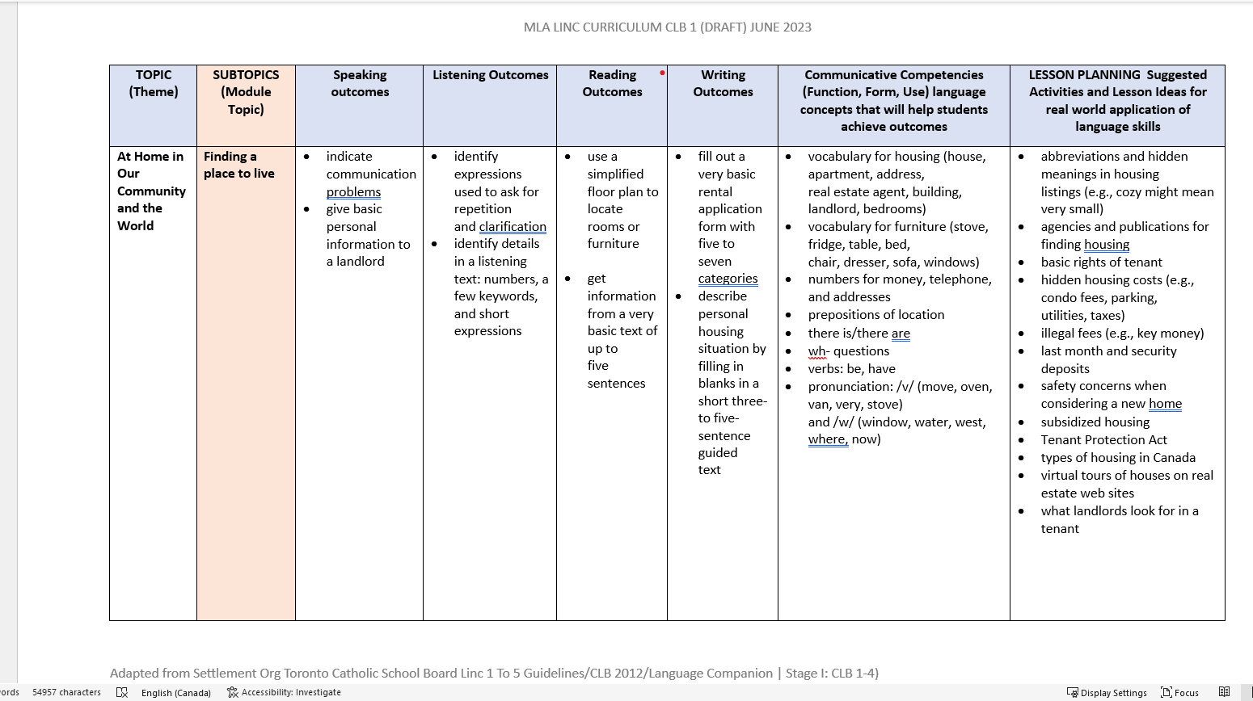
WORD File for each level – (Link to document on Teams)
Each level is divided by themes, topics , language strand outcomes, language concepts, lesson plan ideas

Slide 4
Sample Course Plan for CLB 1 – One theme/One module
course plan development

Slide 5
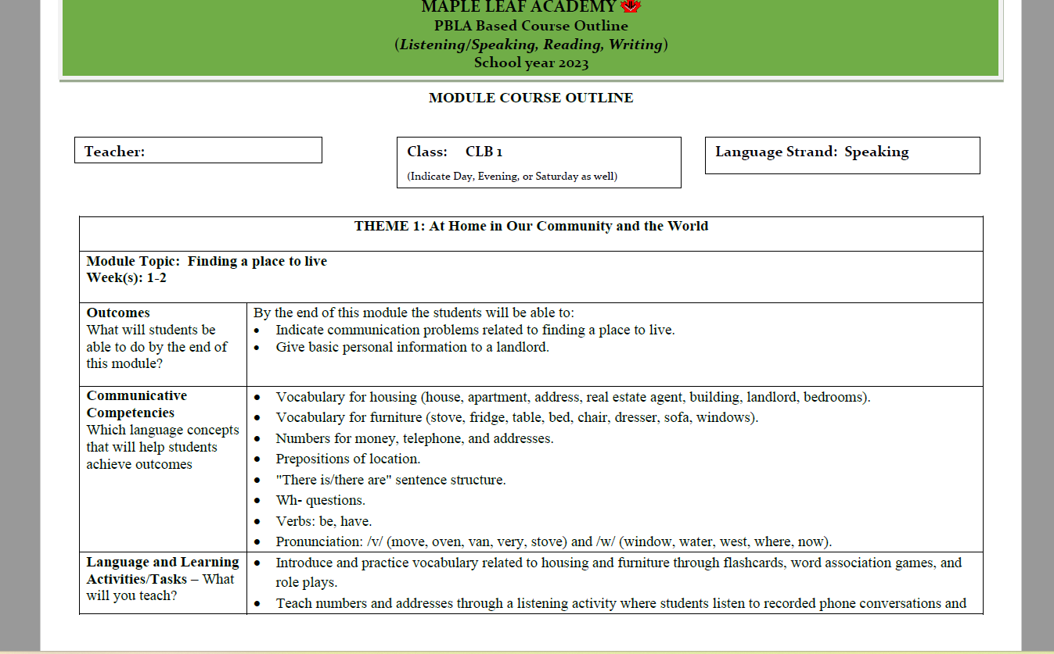
(Link to document on Teams)

Slide 6
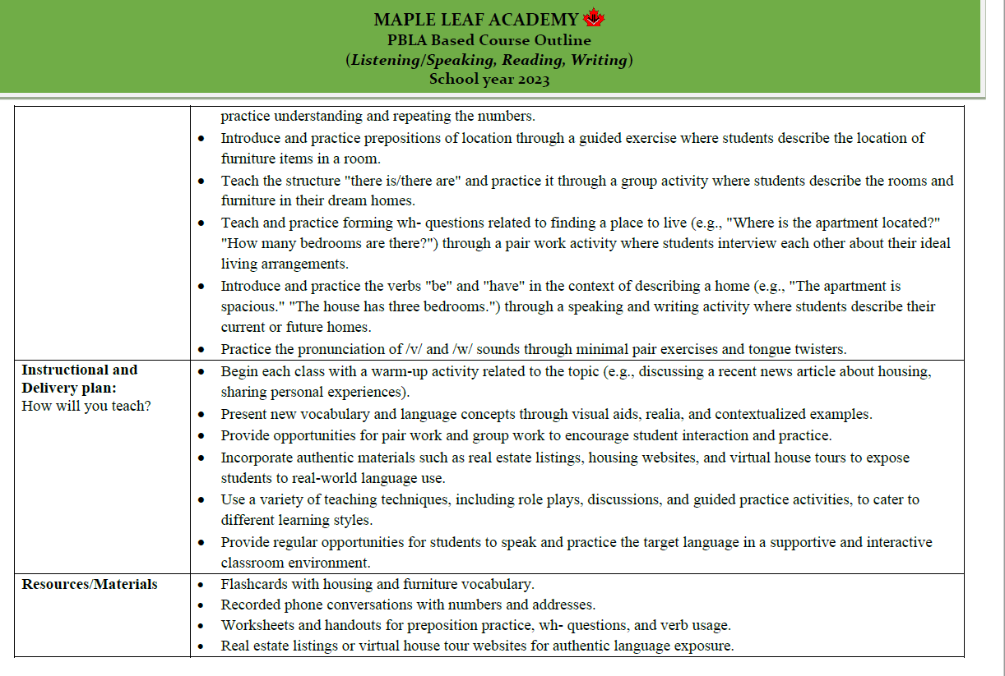

Slide 8
How do you use the framework document to develop your Course Plan?

Slide 9
1
2
Link to document
on Teams
3
4
5
2
1
Link to document on Teams
3
4
5

Slide 10
6
6

Slide 11
Develop learning activities with the help of suggested activities in this section.
7
7

Slide 12
Develop your unique instructional plan that supports students to achieve speaking outcomes
Determine which resources (texts, realia, online articles etc.) that will support students to achieve speaking outcomes.
Determine which tasks from the lessons will be assessed and used as an artifact. Assessments don’t need to be summative and can be a task completed in class or can be a homework task or assignment.

Slide 13
From Course Plan to Lesson Plan

Slide 14
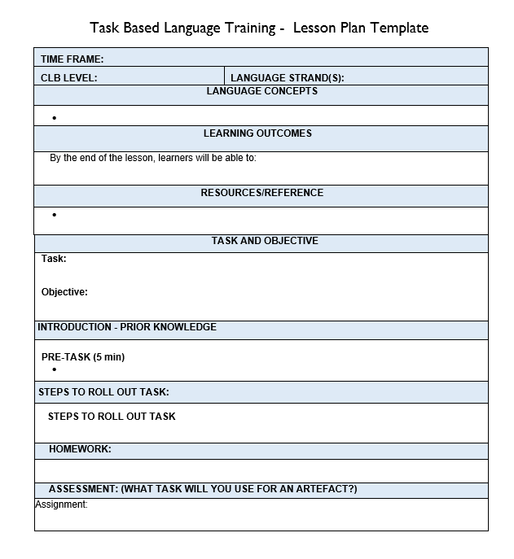
TBLT (Task Based Language Training) Lesson Plan
Link to document in Teams

Slide 15
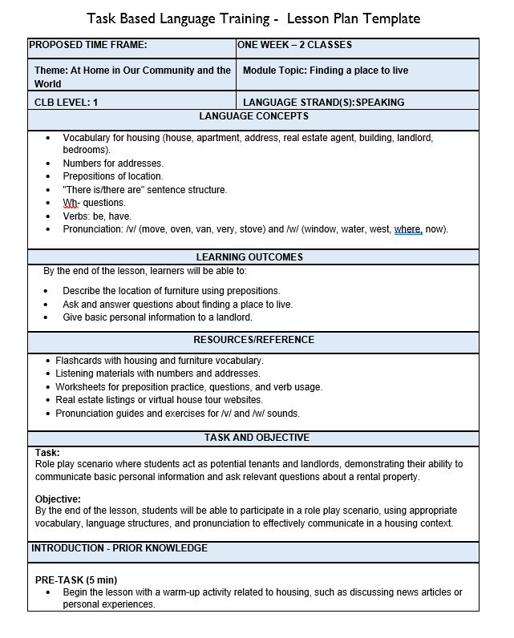
TBLT (Task Based Language Training) Lesson Plan
Link to document on Teams

Slide 16
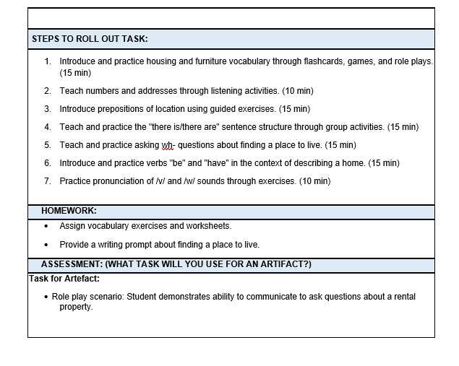
TBLT (Task Based Language Training) Lesson Plan

Slide 17
STUDENT SYLLABUS
A course syllabus serves as a roadmap for adult learners, outlining the content, objectives, assignments, expectations, and schedule of the course.

Slide 18
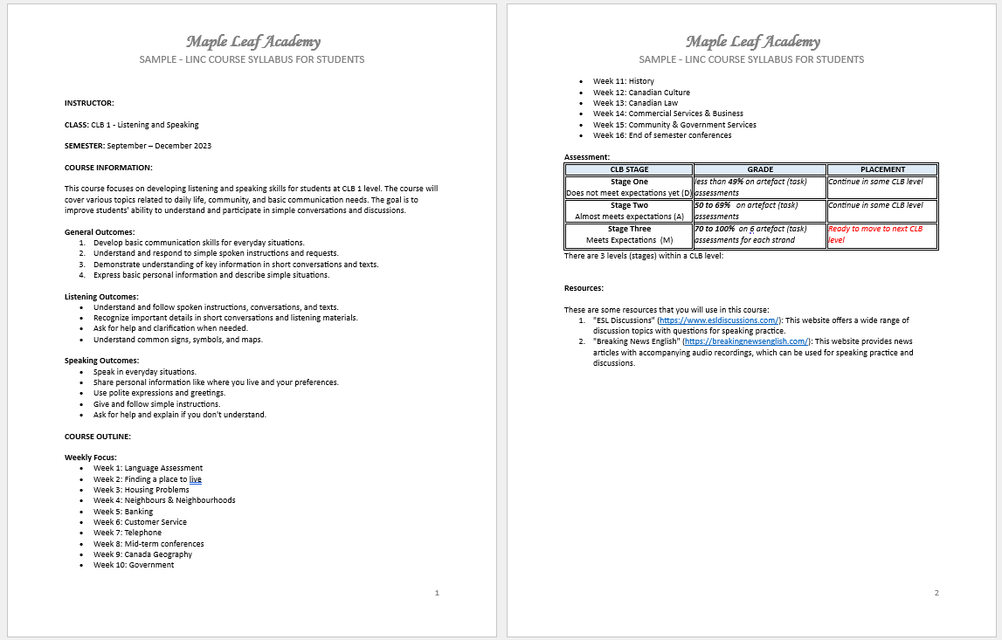
Link to document on Teams

Slide 19
End of month Reflection Report and Success Story

Slide 20
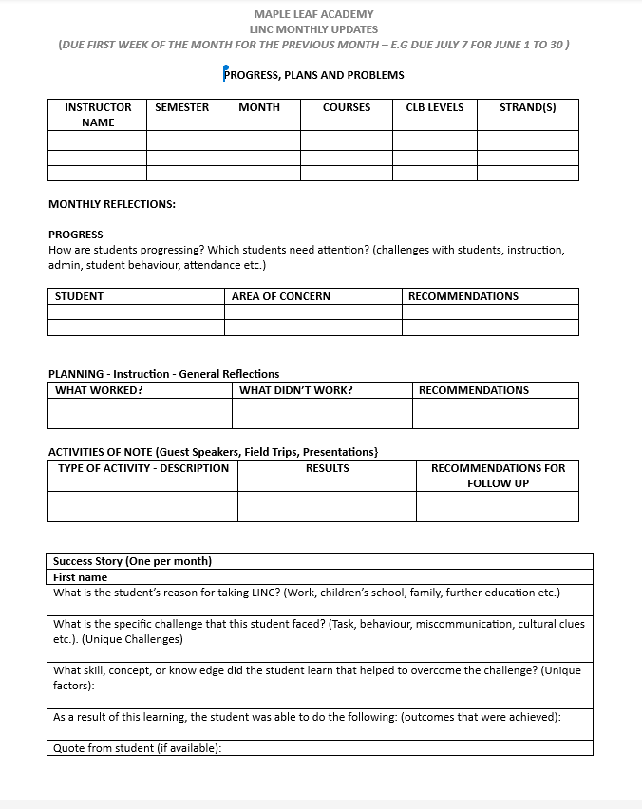
Monthly – End of the Month Reflection
Fill out the monthly report :
what worked,
what didn't work,
student challenges,
teacher challenges.
One success story :
small steps in progress are successes
Link to document on Teams

Slide 21
From Lesson Plan to Assessment
Rubrics and Artefacts for PBLA requirements

Slide 22
PBLA Assessment Requirements:
8 to 10 artefacts for each language strand (speaking, listening, reading, writing)
32 - 40 in total over a 16-week semester
Approximately 1 artefact per strand weekly

Slide 23
Steps to PBLA Assessment
Step #2
Lesson plan – identify task that will be used as an artefact
Step #3
Artefact Assessment Rubric - Assess each artefact against rubric criteria
Step #4
Artefact assessment summary – transfer result from each artefact to this summary
Step #5
Calculate the summary results
Step #6
Student/Teacher meeting
Step #1
Create a schedule - identify when to collect artefacts

Slide 24
Step #1
Create a schedule - identify when to collect artefacts:
Week | 1 | 2 | 3 | 4 | 5 | 6 | 7 | 8 | 9 | 10 | 11 | 12 | 13 | 14 | 15 | 16
Speaking | Language assessment | x | Needs Assessment | x | x | x | x | Midsemester Conference | x | x |  | x |  | x | x | End of Semester Conference
Listening |  | x |  | x | x | x | x |  | x | x |  | x |  | x | x
Reading |  | x |  | x | x | x | x |  | x | x |  | x |  | x | x
Writing |  | x |  | x | x | x | x |  | x | x |  | x |  | x | x

Slide 25
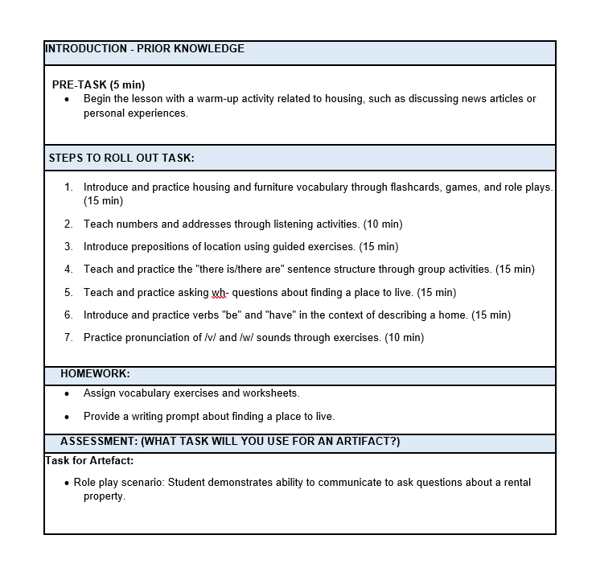
Step #2
Lesson plan – identify task that will be used as an artefact

Slide 26
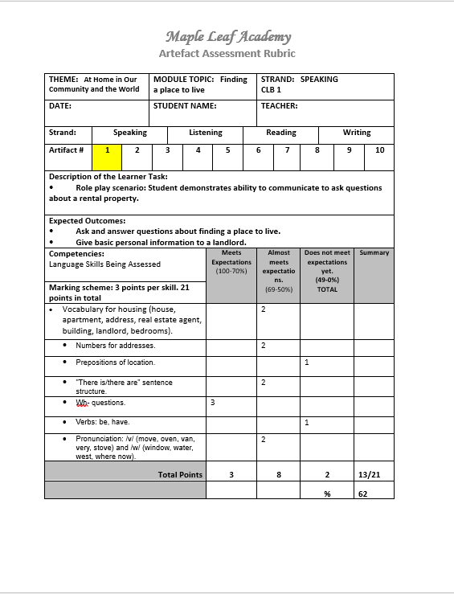
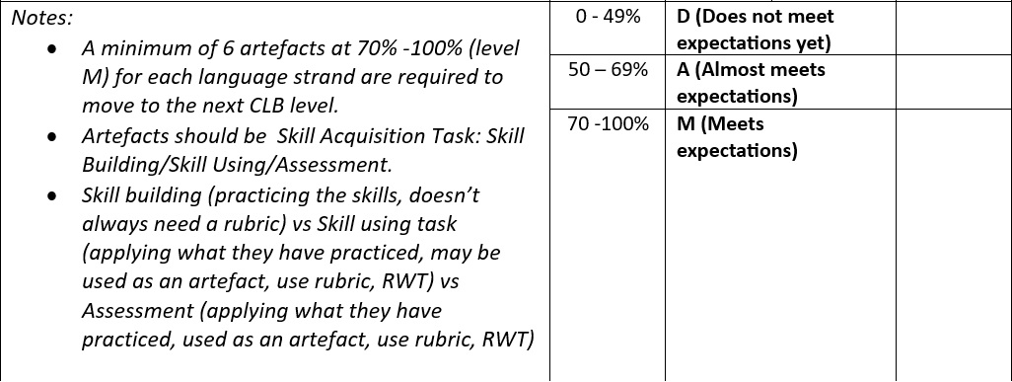
Step #3
Artefact Assessment Rubric - Assess each artefact against rubric criteria
Link to document on Teams

Slide 27
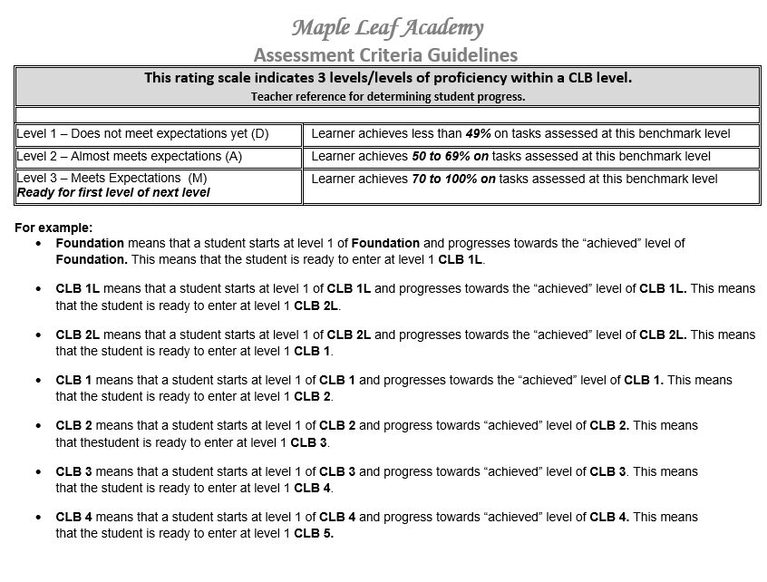
RUBRIC ASSESSMENT CRITERIA EXPLAINED
Link to document on Teams

Slide 28
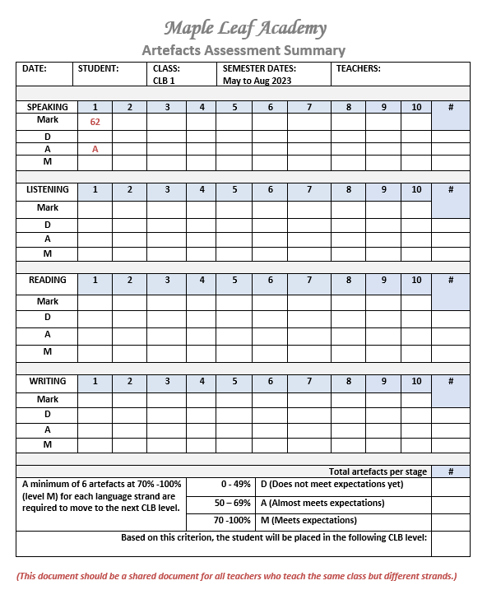
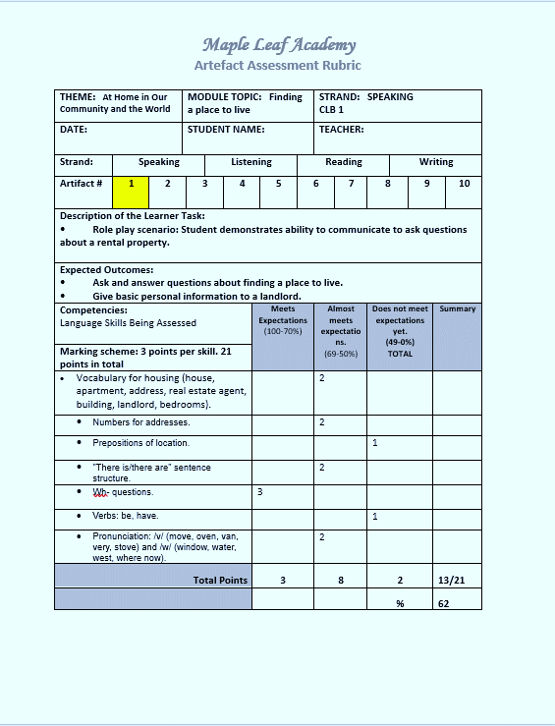
Step #4
Artefact assessment summary – transfer result from each artefact to this summary

Slide 29
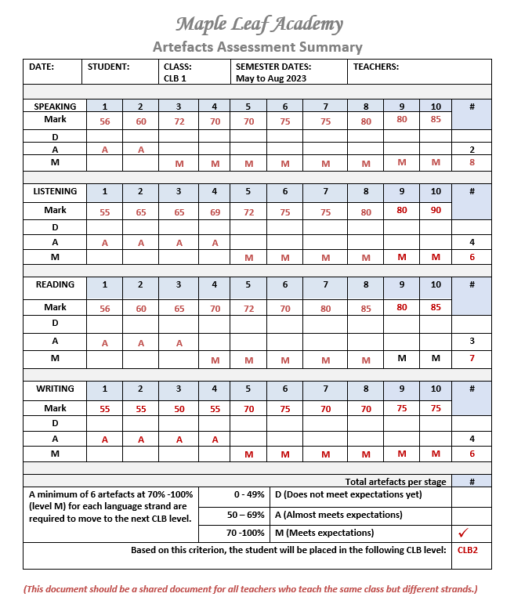
Step #5
Calculate the summary results
Link to document on Teams

Slide 30
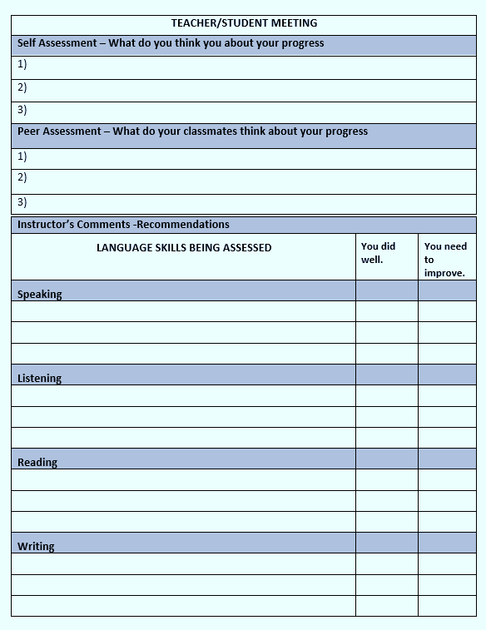
Step #6
Student/Teacher meeting
Use these two documents to review progress and placement with your student.
Link to document on Teams

Slide 31
Schedule of Planning, Delivery, Reporting and Assessment Steps
Each Semester – Course Plan
Documents that you will need:
* Curriculum Framework
* Course Plan Template
* Student Syllabus
Choose theme and module topics by strand that you are teaching.
Create a plan from the selection of themes and modules to create a 16-week plan
Weekly – Lesson Plan
* Create lesson plan(s) for each strand you are teaching.
* Refer to the semester plan to create daily or weekly plans.
* Select artefacts to assess for the week (refer to your artifact schedule).
Monthly – End of the Month Reflection
*Fill out the monthly report : what worked, what didn't work, student challenges, teacher challenges.
*One success story
Mid and End of Semester
*Review and assess artefacts using rubric template
* Meet with students to review progress and placement for next semester

Slide 32
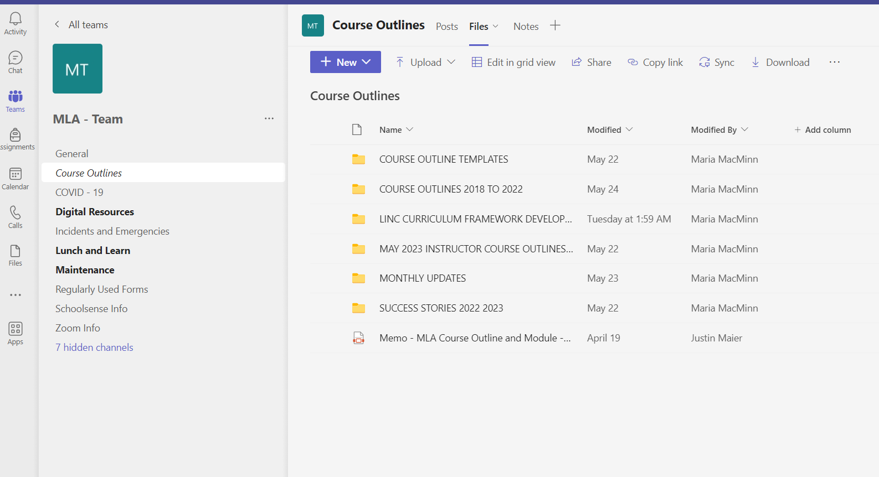
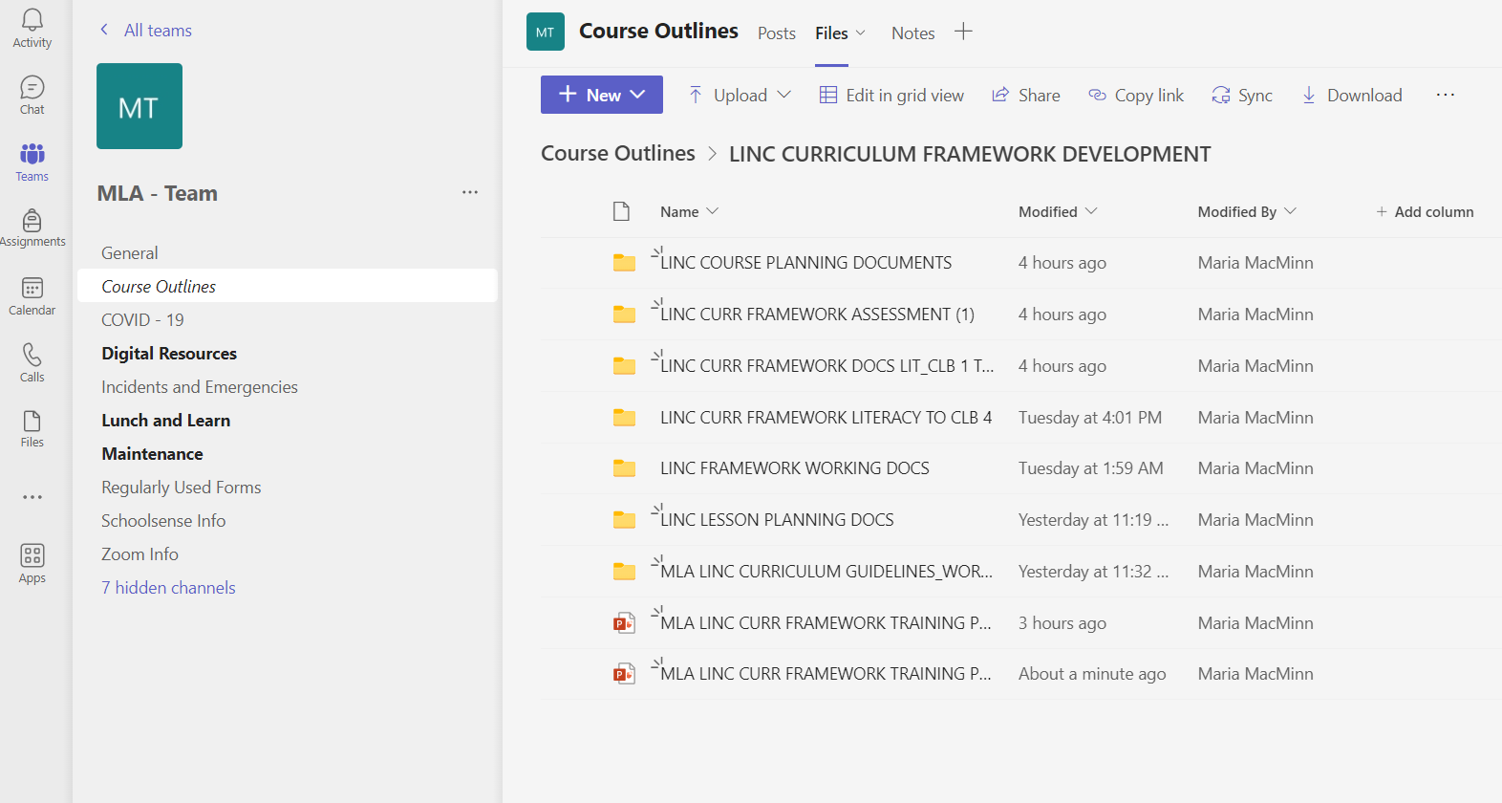
Teams Document Locations

