Slide 1
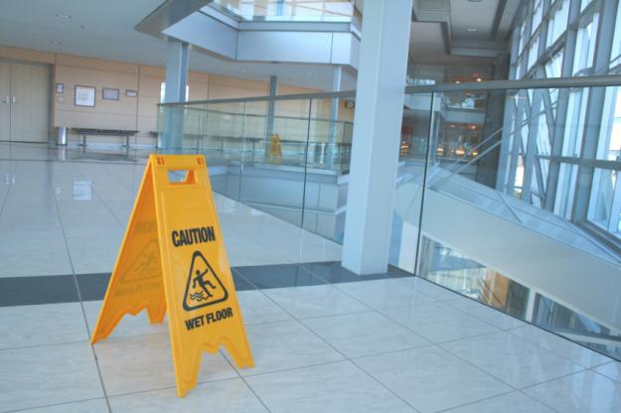
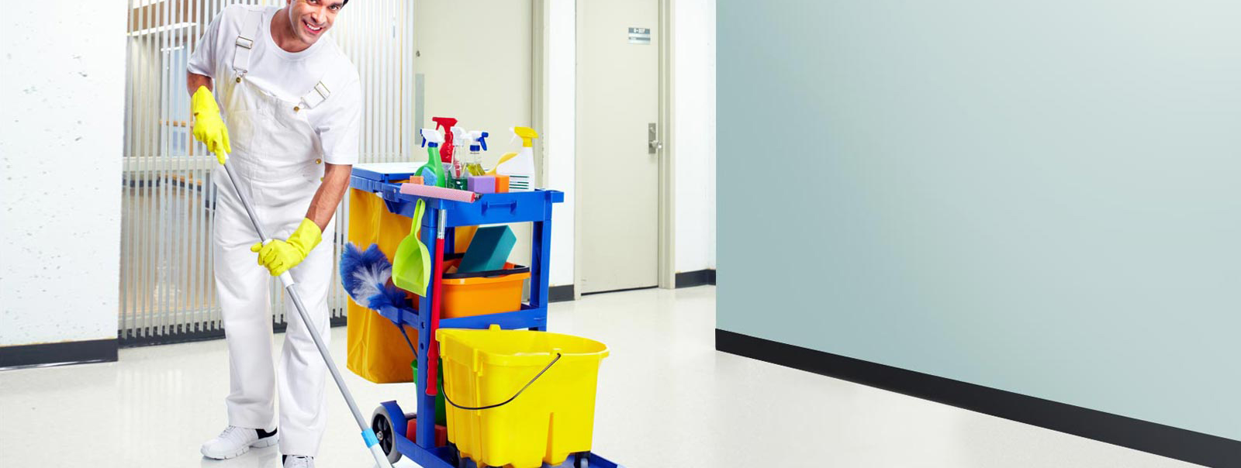
ESL FOR INDUSTRIAL CLEANER PROGRAM
©2016 Keyano College
These Photos by Unknown Author is licensed under CC BY-NC-ND

Slide 2

Day 5
Workplace Digital Communication Skills
This Photo by Unknown Author is licensed under CC BY-SA

Slide 3
Day 5
Outcomes
By the end of this module unit, students will be able to:
1. Demonstrate writing strategies for the workplace
2. Apply business writing strategies for emails and cover letters
3. Apply appropriate vocabulary to demonstrate concise and clear language workplace language
Notes:
Review outcomes with students – 10 minutes
Answer questions that may come up

Slide 4
Class Discussion
Computer skills for the workplace
What computer skills do you need?
What kind of language do you use for emails, texts?
Notes:
10 minutes introductory discussion:
Ask questions and guide conversation:
Computer skills for the workplace
• What computer skills do you need – computer for entering work hours, phone for texts and phone calls, inventory records, incident reports
• What kind of language do you use for emails, texts; common phrases you can use for different situations

Slide 5
Concise Writing
What is another word for “concise”?
Use your dictionary or google the word on the internet.
Brainstorm the different words or phrases that mean “concise”.
Notes:
10 minutes brainstorming discussion:
What is another word for “concise”
Ask students to research
Take notes on whiteboard (online or in classroom)
Use the following information from google page https://www.google.com/search?q=concise&rlz=1C1CHBF_enCA871CA871&oq=concise&aqs=chrome..69i57j0i3j0i433i512j0i512l6j0i3.4677j0j15&sourceid=chrome&ie=UTF-8
What do you mean by being concise?:
Concise, succinct, terse all refer to speech or writing that uses few words to say much. Concise usually implies that unnecessary details or verbiage have been eliminated from a more wordy statement: a concise summary of the speech.
Some questions you can ask:
What do you mean by being concise?
What is the synonym for concise?
Does concise mean short?
Is concise an adjective?

Slide 6
Strategies For Concise Writing
Keep it tight. – What do you think this phrase means?
  Short sentences, short paragraphs and short documents
  Why do you think that short sentences are best?
Delete redundant adjectives. All friends are personal; all innovations are new; all disasters are serious.
  Why are the words in red not necessary?
Notes:
Keep it tight. – What do you think this phrase means?
• Short sentences, short paragraphs and short documents
Ask:
Why are short sentences better?
Answer:
have a better chance of capturing readers’ attention. That’s particularly true of e-mails and other electronic documents because we read more slowly on screen than on paper. Cut the flab to keep your readers. Here are a few tips:
• Delete redundant adjectives. All friends are personal; all innovations are new; all disasters are serious.
o Why are the words in red not necessary?

Slide 7
Concise Writing - Eliminate Extra Words
Don’t disguise your verbs as verb/noun pairs. Don’t “make a decision” or “carry out an improvement.” Just “decide” or “improve.”
Cut prepositional phrases. Why say “We are in the process of upgrading our IT systems” when you can simply say “We are upgrading our IT systems”?
Tip: Pretend the document you’re working on is a telegram and every word costs you $10. Edit (change) accordingly.
Notes:
•Don’t disguise your verbs as verb/noun pairs. Don’t “make a decision” or “carry out an improvement.” Just “decide” or “improve.”
Ask students - What is the difference between the two phrases? What words are extra or unnecessary?
• Cut prepositional phrases. Why say “We are in the process of upgrading our IT systems” when you can simply say “We are upgrading our IT systems”?
Ask students: What are some other examples of unnecessary prepositional phrases?
Go over this with students. Explain the words “tip”, “telegram”, “edit”
Tip: Pretend the document you’re working on is a telegram and every word costs you $10. Edit (change) accordingly.

Slide 8
Apply Strategies
Task #1 - Handout #1
Read the text and answer the questions.
Share with a partner to decide on the best answer.
Notes:
20 minutes
Review the task with the students
Refer to Task #1 Handout #1
Answer questions
Answer question #1 with students to help with activity
Students work individually
Students compare with their partner
Review answers with whole class

Slide 9

Single Words
Use single words instead of phrases with a lot of prepositions.
For example:
because instead of: as a result of
regarding instead of: with regard to
to, for instead of: for the purpose of
if instead of: In the event that
Notes:
15 minutes
Being concise involves stating only the important information and avoiding irrelevant details. Here are a few more tips to help you write concisely.
Refer to the ppt slide

Slide 10

Modals
Use modals instead of phrases to express necessity, possibility or ability.
For example:
We might have a meeting tomorrow.
instead of:
There is a possibility that we will have a meeting tomorrow.
He can operate the equipment.
instead of:
He has the ability to operate the equipment.
Notes:
15 minutes
Being concise involves stating only the important information and avoiding irrelevant details. Here are a few more tips to help you write concisely.

Slide 11
Simple Grammar
Use sentences that are grammatically simple.
You are less likely to make grammatical errors if you avoid complicated sentences.
Try to keep your sentences short, with one idea per sentence.
For example:
We met to discuss the new proposal.
instead of:
The purpose of the meeting was to discuss the new proposal.
Notes:
15 minutes
Being concise involves stating only the important information and avoiding irrelevant details. Here are a few tips to help you write concisely.

Slide 12
Apply Strategies
Task
Task #2 - Handout #1
Answer
Answer the questions and learn more about using language.
Share
Share with a partner to decide on the best answer.
Notes:
30 minutes
Review the task with the students
Refer to Task #2 Handout #1
Answer questions
Answer question #1 with students to help with activity
Students work in pairs
Review answers with whole class

Slide 13

Emails
Email = electronic mail.
90% of email is spam or advertisements.
Questions:
Why do people write emails?
How important are spelling, punctuation, and formatting?
Who do we send informal emails to?
Who do we send formal emails to?
Notes:
10 minutes
Discuss emails and answer questions as a class

Slide 14
Parts of an Email
Send icon:
Address of person getting the email:
Address of a person who gets a copy of the email:
Subject Line: Add a subject
Attachment:
Compose Message:
Notes:
10 minutes
Review parts of the email

Slide 15
Email Programs
What kinds of email programs are out there?
Gmail
Outlook
Yahoo!
Others…
Which ones do you use?
Notes:
10 minutes
Review and discuss

Slide 16
Email Addresses
An email address has five parts. Don’t put spaces between:
  Letters and/or numbers + @ + letters + . + com OR ca OR org OR net
  For example: Halimaali12@gmail.com or Helen.Dhong@yahoo.com
The address is not good. = The person does not get the message.
Common message for bad addresses:
“Delivery has failed to this recipient. The email address you entered could not be found. Please check the recipient’s email address and resend the message.”
Notes:
5 minutes
Review and discuss

Slide 17
Email Addresses
Find problems in theses email addresses:
sami12gmail.com
Ali.Mohammed@hotmailcom
Oldman @yahoo.com
daavidjones@mailuni.c om
teacherbob@school.cim
123karatekicks.com
Notes:
10 minutes minutes
Review, discuss and locate the errors together

Slide 18
Professional Emails - Addresses
Your email address should look professional for business or formal emails.
Not: prettykitty@gmail.com
It should have some of your name in it. Then it doesn’t look like spam.
  Which would you trust? 12345ft@gmail.com
                or
                smith@gmail.com
Notes:
5 minutes
Review and discuss

Slide 19
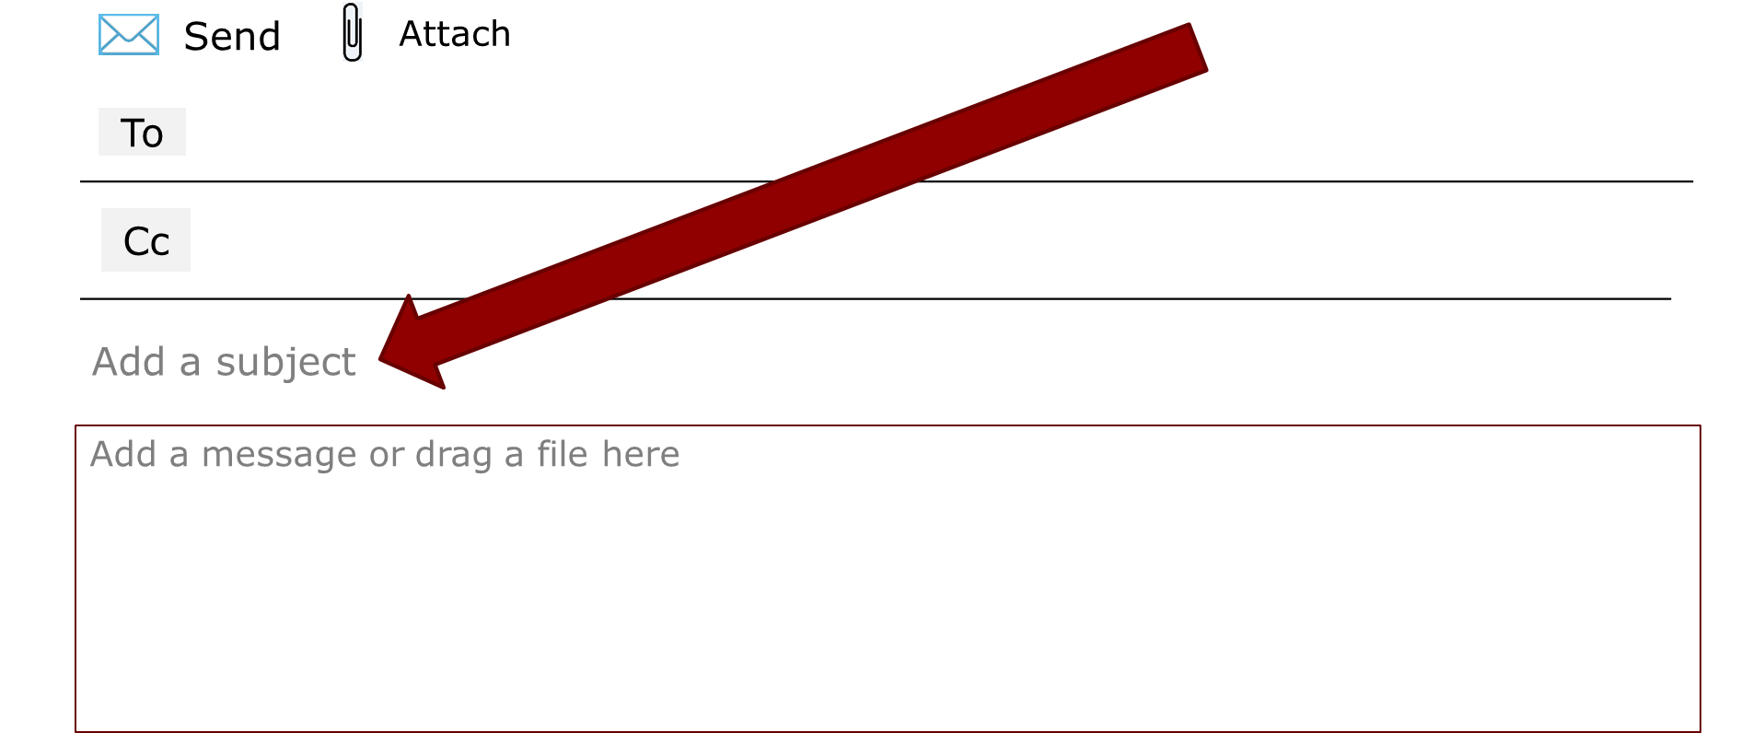
Emails – Subject Line
Notes:
Explain that you are going to discuss dos and don’ts of how to write a subject line
Review, discuss and locate the errors together

Slide 20
Emails – Subject Line
DO
  Put information in the Subject box.
  Write a short subject.
  Write a subject that a recipient will want to open.
DON’T
  Write in all caps – LIKE THIS.
  Use sentences.
Notes:
Explain that you are going to discuss dos and don’ts of how to write a subject line
Review, discuss and locate the errors together

Slide 21
Professional Subject Lines
Task - #2
What could your subject be in these situations?
  sending in a report
  message to family about weekend plans
  informal baby shower invitation
  message to boss asking for a day off
  message to co-worker asking to switch shifts
Work with a partner and write subject lines on handout #2.
Notes:
15 minutes:
Review the task
Task - #2 (Handout #2)
Assign partners to complete
Share with the class

Slide 22
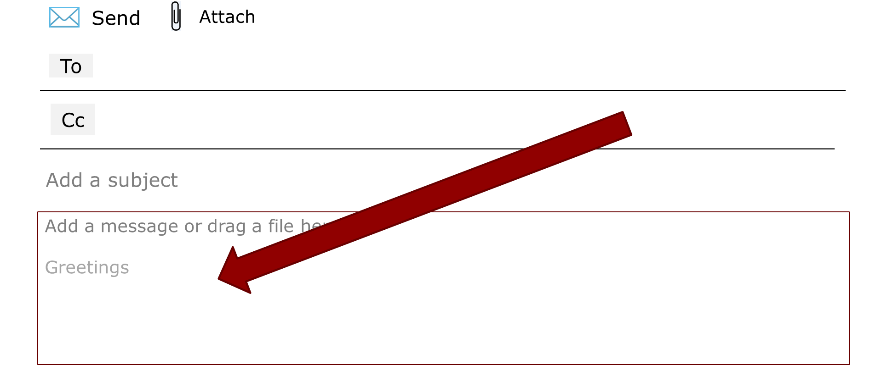
Emails - Greetings
Greet your recipient.
Spell their name correctly and use a CAPITAL letter for the first letter.
Use a comma (,) or semicolon (;) after the greeting. Very formal greetings will use a colon (:).
Notes:
Introduce writing a greeting
Refer to the next slide for forms of greetings.

Slide 23
Emails - Greetings
Usual greetings are…
Formal Informal
Dear Mr. Williams; Hi Adam,
Dear Ms. Gomez; Hi guys,
Dear Mrs. Harrington: Hello ladies,
Dear Sir, Hi all,
Dear Madam;
To Whom it May Concern:
Attn: Principal Smith
Attn: Human Resources Manager
In the workplace … if you use first names with your boss, you can use a first name. e.g.Good afternoon/morning/evening, Paulo:
Notes:
Introduce writing a greeting
Review and discuss the different greetings.
Which would you use in the workplace?
When do you use a first name in the workplace?

Slide 24
Task #3
Write Email Greetings
Which greeting should you use for…
  An email to your manager. Her name is Nadia Orlov.
  An email to your best friend. His name is Jamal Lewis.
  An email to your co-worker. Their name is Alexis Rella.
  An email to everyone in your department at work.
  An email to many family members.
Notes:
20 minutes
Refer students to Handout #2 – Task #3a and b to complete this task
Share with the class

Slide 25
Emails - The Body
An email should have 2 or 3 parts.
Emails should not be too long.
Don’t change the formatting (font, colour). Your recipient’s email system may be different from yours and they won’t see it, or the message might look strange.
Part 1: Introduce yourself. (First time emails only.)
Say why you are writing.
Space
Part 2: Give details.
Space
Part 3: Give any special information. Write about any attachments.
Notes:
Introduce writing a greeting
Review and discuss the different greetings.
Which would you use in the workplace?
When do you use a first name in the workplace?

Slide 26
Emails - E-Signature
  We can not sign our names with a pen. You can type a signature at the end of emails.
  This could have your work position, business address, website address or social media accounts like Facebook.
  Example: Martin Smith
Line Worker, Walmart
  T 780-345-6789 | C 780-123-4567
  12345 67 Avenue
  Daysland, Alberta Canada T5L 1C3
  msmith@yahoo.ca
Notes:
Introduce writing an e-signature
Review and discuss different examples of e –signature
Ask students to create their own e-signatures
Which would you use for the workplace?
Which would you use for your personal email?

Slide 27
Emails - Being Clear and Concise
Task #4 – Handout #3
Read the email memo sent to employees.
Work with a partner to answer the questions
Share your answers with the class
Notes:
15 minutes:
Review the task
Task - #4 (Handout #2)
Assign partners to complete
Share with the class

Slide 28
Formal or Informal Message? Why?
Close
Compose
Send
To: leo.pong@gmail.com
______________________________________________________________________
Subject: Wow!!
______________________________________________________________________
Hey Leo,
The job’s mine! The boss called me today. I start on Mon.
Great!!!!!!!!!!!!!! Call me
Send
Notes:
Ask learners what makes this email informal. It is informal because:
The subject line is not professional.
“Hey” is slang.
There is no closing name.
Mon. is abbreviated.
It uses a contraction.
There are many exclamation marks after the word “Great.”

Slide 29
Formal or Informal Message? Why?
Close
Compose
Send
To: leo.pong@gmail.com
______________________________________________________________
Subject: Part-time Office Worker __________________________________________________
Hello Mr. Hassan:
I am writing to let you know I am interested in the part-time position you advertised online. My name is Malenben Depac. You can reach me at 897-335-1234.
Sincerely,
Malenben Depac
Send
Notes:
Ask learners what makes this email formal. It is formal because:
Subject line is formal.
“Hello” is a formal greeting.
A colon is used after the greeting.
Full sentences are used.
The closing is formal.

Slide 30
Example Emails
Formal (Business)
Sender: Easy Peasy Print
Subject: Quote for Calendars
Recipient: Aaron Hampton
Dear Mr. Hampton
Hello. I am Warren Bean, a sales person for Easy Peasy Print. Thank you for your questions.
The cost of printing for your calendars will be $235.00. The fees are in the attached document. Please confirm your order. We can send you the calendars next week.
Please ask if you have more questions. You can reach me by phone or email.
Sincerely,
Warren Bean, Easy Peasy Sales Rep
T 224-778-9999
eazypeasy@gmail.com
http://www.eazypeasy.ca

Slide 31
Example Emails
Informal (Social)
Sender: Olivia Ng
Subject: Book Club This Week
Recipients: Melanie Myers, Winnie and Fam, Dionnes, Franz VanHooft
Hey everyone,
Book club is at my house tonight. The book is “Falling Down Easily” by Lucie McQueen. I can’t wait to talk to you about it.
My address is 22 Greene Lane. You can park on the street. Come any time after 8 p.m.
Cheers,
Olivia
P.S. Bring questions!

Slide 32
Email Safety Tips
Some emails are advertisements.
Some emails are spam = emails from people or companies you don’t know.
Spam emails can have viruses. Viruses can destroy your computer.
Never open attachments from senders you don’t trust!

Slide 33
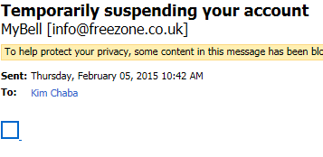
Email Safety Tips
Is an email safe to open? How do you know?
  The subject line can help you.
Here are some red flags:
  Subjects ALL IN CAPS
  Subjects that have the word FREE
  Subjects with a % number
  Grammar is bad in the subject and body
  Return email address doesn’t have the company name in it
** MyBell is NOT my service provider, so I know for sure this message is spam and may have a virus.

Slide 34
Email Safety Tips
Which subject lines look OK and which look like spam?
____________ FREE tickets. CLICK HERE.
____________ Pst. This offer is only for you.
____________ Tim and Susan’s Wedding
____________ We waiting answer. Only 5 days left!
____________ Dinner next week
____________ 50% of the classes are full! Earn 2x the points.
Notes:
5 to 10 minutes
Discuss with class.
Elicit answers

Slide 35
The 3 Parts of an Email
Greeting SPACE Part 1: Introduction & Reason for Writing SPACE Part 2: Details SPACE Part 3: Closing & Possible Thanks SPACE Signature lines
Notes:
The email is usually divided into three parts. Emails should not be too long, so you do not need to write a lot of information in each section.
Don’t change the font size or colour. Also, we don’t usually indent the first line.
Leave a space after the greeting before you start the first part of the email. Then leave a space after each part. See the diagram below.

Slide 36
Email - Part 1: Introduction and Reason for Writing
In Part 1:
Introduce yourself :
(e.g., My name is ______.), if you do not already know the recipient.
Say why you are writing the message:
(e.g., I am writing this email because ______ (more formal)
or
Do you want to have lunch? (more informal).
Do not add details here. You will have a chance to add details in the next section.
Notes:
The email is usually divided into three parts. Emails should not be too long, so you do not need to write a lot of information in each section.
Don’t change the font size or colour. Also, we don’t usually indent the first line.
Leave a space after the greeting before you start the first part of the email. Then leave a space after each part. See the diagram below.

Slide 37
Write an Email
Task
Task #5 – handout #4:
Write
Write a few sentences for Part I of each email
Compare
Compare with a partner
Share
Share with the class.
Notes:
Review the task with the class.
Answer questions about the task.
Complete the first one with the class.

Slide 38
Email - Part 2: Details
Part 2: Details
In part 2, give the details about the reason you are writing.
For example, if you want to meet a friend for lunch, you could suggest a day and time.
You could also suggest a restaurant or a place to meet.
If you are writing about applying for a job, give details about why you would be good for the position.

Slide 39
Email - Part 2: Details
Task
Task #6 – handout #5:
Write
Write a few sentences for Part 2 of each email.
Compare
Compare with a partner.
Share
Share with the class.
Notes:
Review the task with the class.
Answer questions about the task.
Complete the first one with the class.

Slide 40
Email - Part 3: Closing
Part 3: Closing
Some common expression that you can use in this part are:
Please contact me about this.
I look forward to your reply.
Please do not hesitate to contact me if you have any questions.
I look forward to hearing from you.
Please let me know when you are available to meet.
Call me when you have a minute. (more informal)
Please find attached my resume.
Thank you for considering my request.
You can reach me at _________ (phone number or email)
Notes:
In part 3, you can ask the recipient to respond to your message or tell them you are looking forward to receiving their reply. You should tell them what you want next. If you have attached any documents to the email message, you should mention them here. This is also the time to say thank you for what someone might do for you or what they did for you. In formal messages, this is the part where you might give them your contact information if you are asking them to contact you in person and not through email.

Slide 41
Email - Part 3: Closing
Task
Write
Write a few sentences for Part 3 of each email.
Compare
Compare with a partner.
Share
Share with the class.
Task #7 –Handout #6
Notes:
Review the task with the class.
Answer questions about the task.
Complete the first one with the class.

Slide 42
Email – Signature Lines
This section is a polite way to end an email.
Formal | Informal
Sincerely, (First & Last Name) Best Regards, (First & Last Name) Respectfully, (First & Last Name) | See you soon, (First Name) Cheers, (First Name) Bye for now, (First Name)
Notes:
This section is a polite way to end an email. It starts with a capital letter and ends with a comma. This section is similar to saying goodbye and in informal emails, you might use the word goodbye or bye.
In formal messages, you should include a goodbye word or phrase as well as your first and last name. Your name goes on the line under the closing. We do not always use closings in informal messages. If you do use one, you should not include your last name.

Slide 43
Email - Part 3: Closing
Task
Task #8 –Handout #7
Write
Write the appropriate signature lines for the following situations. Include your name.
Compare
Compare with a partner.
Share
Share with the class.
Notes:
Review the task with the class.
Answer questions about the task.
Complete the first one with the class.

Slide 44
Email - Assignment
Task
Task #9 – Handout #7 - Assignment
Put
Put the Practice Emails Together
Put
Put the practice email parts from above together. Do not forget to leave a space after each part.
Include
Include a subject, greeting and signature lines.
Submit
Submit your completed assignment for assessment.
Notes:
Review the task with the class.
Answer questions about the task.
Assignment for students to complete and submit for assessment.
Email the assignment to students so that they can complete it with their personal email or they can fill in the email document and submit to you.

Slide 45
Final Email Checklist
Did I type the email address correctly?
Did I type a good subject?
Did I have a greeting?
Did I have all the body sections?
Did I close the email?
Did I use the right tone (formal / informal)?
Did I attach a document that I said would be attached?
Did I check my email for spelling and grammar mistakes before I clicked on “Send”?
Notes:
Review with the students the checklist for completing the assignment.
Read each item on this list separately.

